Slide 1
Credit Risk Analytics
Home Equity Loan
MBC-638-Fall’18

Slide 2

Meet Our Team
Yaowei Huang
MS in Business Analytics
Mingshun Lu, MS in Marketing
Anuj Jain
MS in Information Management
Harsh Darji
MS in Applied Data Science
Eashani Deorukhkar
MS in Applied Data Science

Slide 3
Agenda Style
A
Introduction
Data Collection
Description of Variables
Sample
A
Descriptive Analysis
Summary by Variables
Conclusion & Recommendations
B
Association Between Variables
Analyzing Variable Relationship
Comparison of Correlation results
Logistic Regression
B
Business Implications
Interpretation
Conclusion

Slide 4
Introduction
Data Collection
Description of Variables
Sample

Slide 5
Data Collection
Data source:
Credit Risk Analytics ( http://www.creditriskanalytics.net )
Data set:
HMEQ (Home Equity)
The data set reports characteristics and delinquency information for home equity loans
Home equity loan - a loan where the obligor uses the equity of his or her home as the underlying collateral
Description:

Slide 6
Description of Variables
Variable | Type | Description
BAD | Qualitative - Dummy variable | 1 = applicant defaulted on loan or seriously delinquent 0 = applicant paid loan
LOAN | Quantitative - Continuous | Amount of the loan request
MORTDUE | Quantitative - Continuous | Amount due on existing mortgage
VALUE | Quantitative - Continuous | Value of current property
REASON | Qualitative - Nominal | DebtCon = debt consolidation HomeImp = home improvement
JOB | Qualitative - Nominal | Occupational categories
YOJ | Quantitative - Discrete | Years at present job
DEROG | Quantitative - Discrete | Number of major derogatory reports
DELINQ | Quantitative - Discrete | Number of delinquent credit lines
CLAGE | Quantitative - Discrete | Age of oldest credit line in months
NINQ | Quantitative - Discrete | Number of recent credit inquiries
CLNO | Quantitative - Discrete | Number of credit lines
DEBTINC | Quantitative - Continuous | Debt-to-income ratio

Slide 7




Sample
Population of Interest
People who are in the needs of loans
01
Random sample of 5960 households
02
Contains households from different types of jobs
The HMEQ dataset can possibly be representative of our population of interest
03

Slide 8
Descriptive Statistics
Summary by Variables
Conclusion & Recommendations

Slide 9
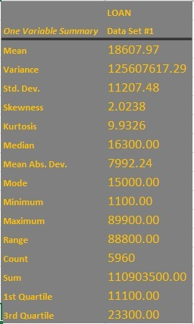
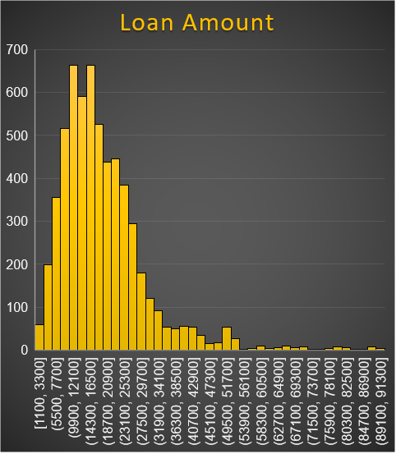
Summary by Variables : Loan amount
Right-skewed
Only a few people apply for large amount of loans

Slide 10
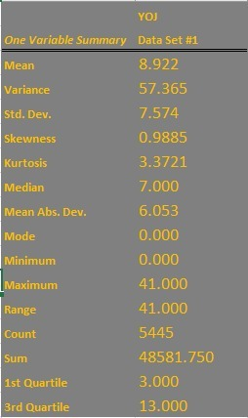
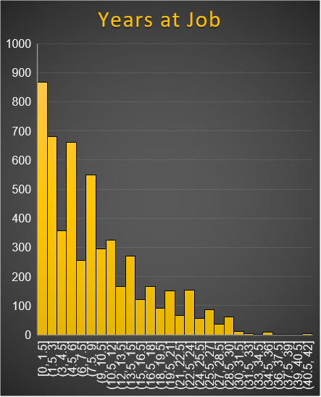
Summary by Variables : Years at job
Many people have few years at a job
A few people have many years at a job

Slide 11
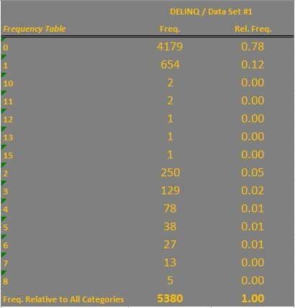
Summary by Variables : Delinq (Number of delinquent credit lines)
Most people do not have any delinquent credit lines.

Slide 12
Summary by Variables : Derog (Number of major derogatory lines)
Most people have no major derogatory reports.

Slide 13
Summary by Variables : Reason
31% people applied loan for home improvement
69% people applied
loan for debt consolidation

Slide 14
Summary by Variables : Job
JOB
Other and Manager take the most percentages of the jobs of he people who applied for loans.
Only 1% of the entire households work for a sales job.

Slide 15
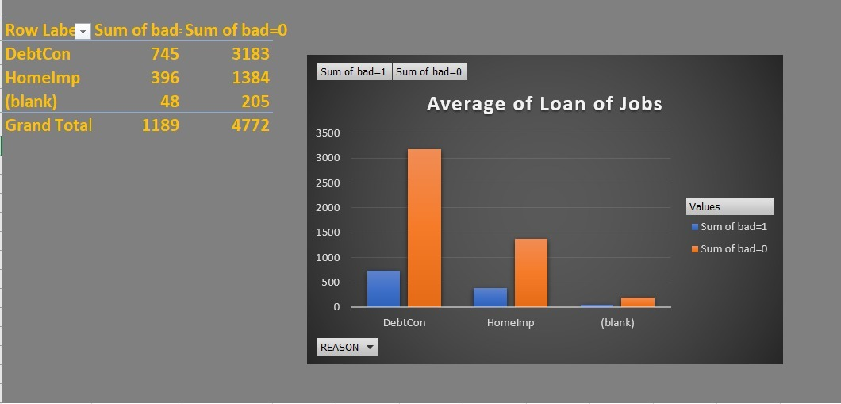
Summary by Variables : Reason
Under both the categories of reason, the number of good borrowers is more than bad.
More people take loans for their debt consolidation as compared to home improvement

Slide 16
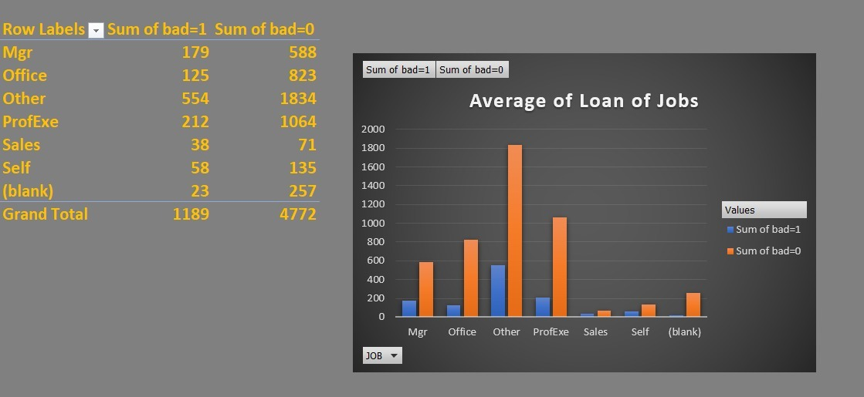
Summary by Variables : Job
In every kind of job, there are more good borrowers than bad borrowers.
The cluster of “Other” jobs amount to the highest number of good borrowers.
The Sales has the lowest number of good borrowers.

Slide 17
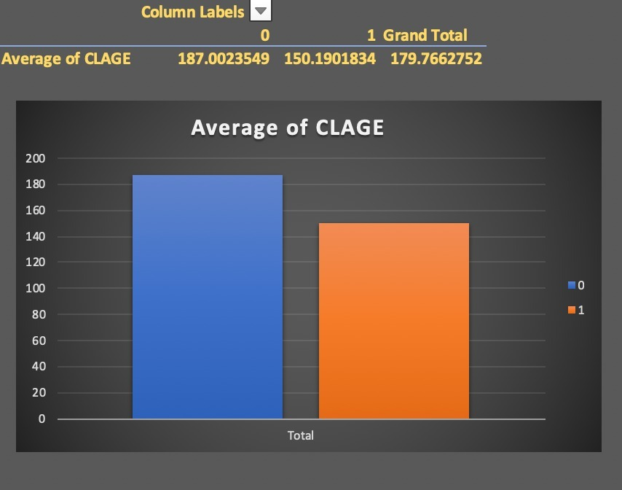
Summary by Variables : CLAGE
Good borrowers have a higher average age of oldest credit lines(months)

Slide 18
Descriptive Analysis Summary
01
02
03
04
Amount of Loan
Delinquent & Derogatory
JOB
CLAGE & Reason Dummy
Most people apply for little amount of loans, so the loan amount may not have very important influence on bad loan
Since most people do not have any delinquent credit lines and no major derogatory reports, the two variables may relate with bad loan closely
Depends on the different rate of bad loan, the differences of reason and job may influence the bad loan a lot
Since most people do not have any delinquent credit lines and no major derogatory reports, the two variables may relate with bad loan closely

Slide 19
Association Between Variables
Analyzing Variable Relationship
Comparison of Correlation results
Logistic Regression

Slide 20
Analyzing Variable Relationship
VALUE
PROFEXE
NINQ
LOAN
CLAGE*Reasondummy
MORTDUE
OFFICE
CLNO
CLAGE
SALES
YOJ
DEROG
REASONDUMMY
DEBTINC
DELINQ
MGR
OTHER
BAD

Slide 21
Dummy & Interaction Variables
Reason
Dummy
Reason
Job Variable
Mgr
Other
Office
ProfExe
sales
Interaction variable
CLAGE *
Reason Dummy

Slide 22
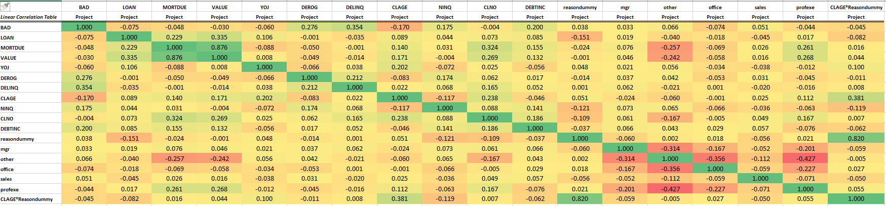
Comparison of Correlation results
From the correlation analysis above, we can understand that correlation does not help us in finding insignificant variables. Correlation helps us find linear relationships between variables which is not useful when it comes to logistic regression

Slide 23
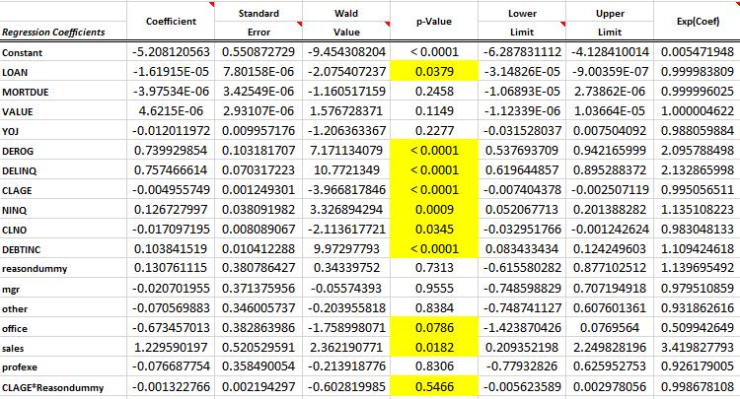
Logistic Regression
We run a logistic regression including all the variables, for predicting if a loan borrower is bad or not. This model has an accuracy of 92.75%

Slide 24
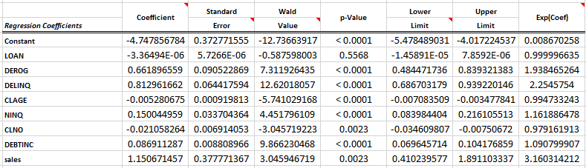
Logistic Regression
Using stepwise logistic regression and considering α=0.05, we build a 2nd logistic regression model using variables which have significant p-value.
Conclusion : This model has an accuracy of 92.15%, lesser than the previous base model. So we consider the earlier model.

Slide 25
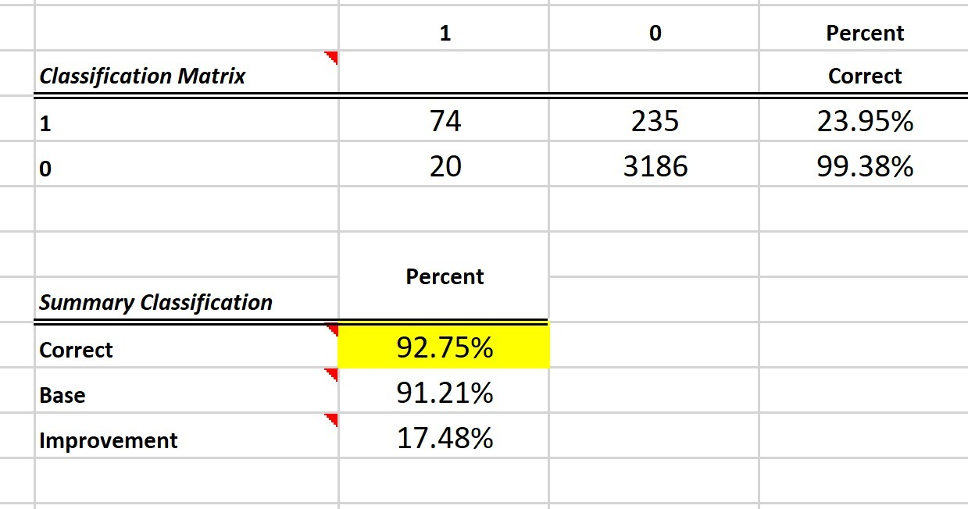
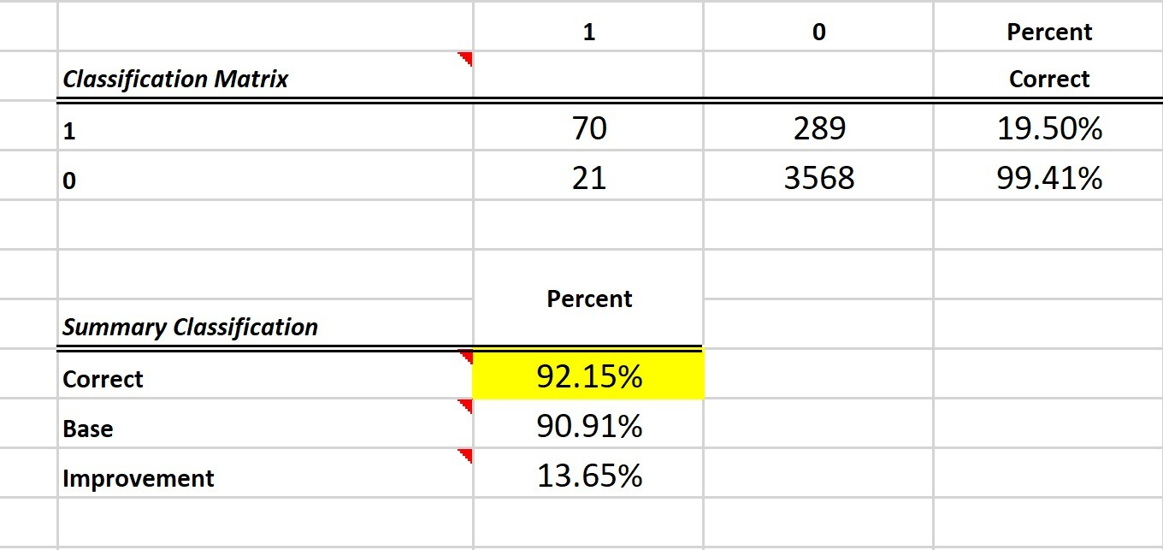
Logistic Regression Accuracies
Model1
Model2

Slide 26
Business Implications
Interpretation
Conclusion

Slide 27
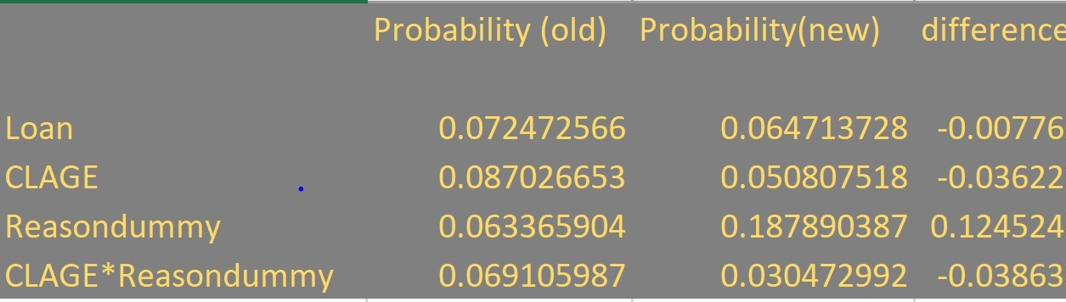
Logistic Regression – Interpretation table

Slide 28
Interpretation of results/Business Implications
Implication: When we increase the value of the loan amount from its 25th percentile to its 75th percentile, the probability of a borrower defaulting on the loan decreases by 0.7% while keeping all other factors constant.
Conclusion: Borrowers with higher loan amounts have a lower chance of defaulting on Home equity loans

Slide 29
Interpretation of results/Business Implications
Interpretation: When we increase the age of the oldest credit line from its 25th percentile to its 75th percentile, the probability of a borrower defaulting on the loan decreases by 3.6% while keeping all other factors constant.
Conclusion: Borrowers with better credit history have a lower chance of defaulting on Home equity loans

Slide 30
Interpretation of results/Business Implications
Implication: The probability of a person defaulting on a loan increases by 12% if the person has a sales job as opposed to a self employed person.
Conclusion: A borrower with a sales job is 12% more likely to default on a home equity loan.

Slide 31
Interpretation of results/Business Implications
Implication: When we increase the age of the oldest credit line from its 0th percentile to its 100th percentile the difference between the probability of defaulting on a loan for people who take a loan for home improvement and those who take a loan for debt consolidation is 3.86%
Conclusion: Borrowers with a better credit history who take a loan for home improvement have a 3.86% lower chance of defaulting as compared to borrowers who take a loan for debt consolidation.

Slide 32
Thank You

